Slide 1
Murdered hip-hop rappers
Why are our rappers dying young?"

Slide 2
Our Deepest Concern and Worry
The year is never complete without a world news about the death of a hip-hop rapper

Slide 3
Wikipedia.org Link
Data Source

Slide 4
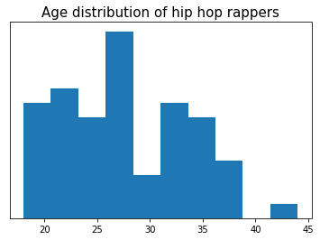
What is the age distribution of our talents

Slide 5
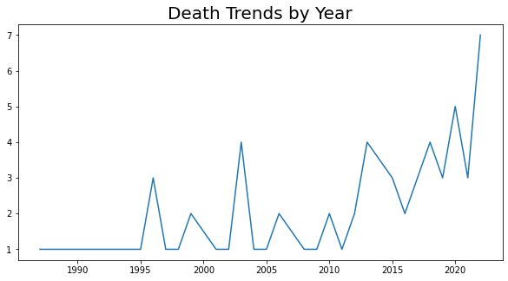
What is the trend of death

Slide 6
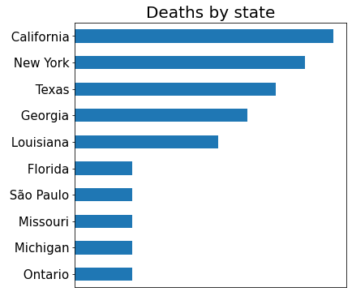
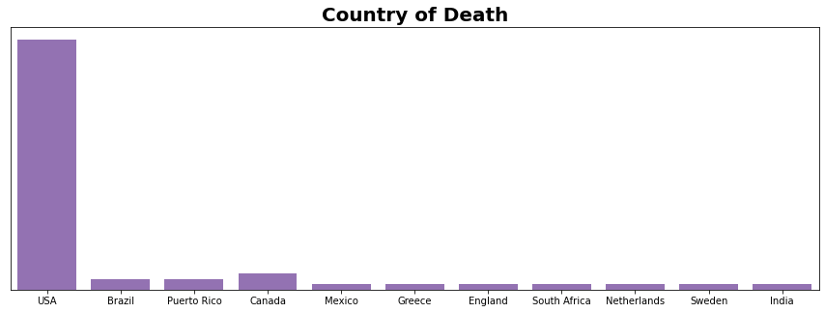
Country with highest death
State with highest death

Slide 7
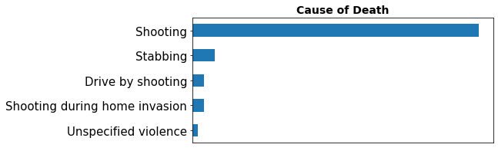
Cause of Death

Slide 8
Recommendations
Illegal possession of arms should be highly checked
More education and social benefits for children in the slums/trenches. Most of these rappers had a rough childhood.
If possible, rappers should be assigned more bodyguards for safety

Slide 9
Appendix

Slide 10
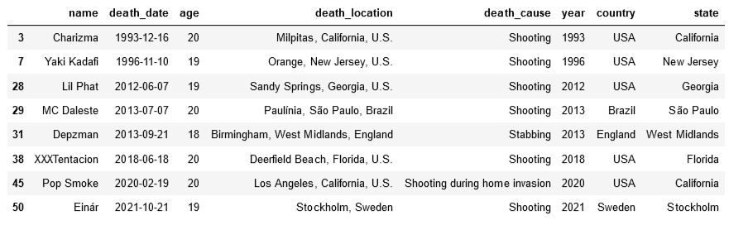
Rappers below 20 years of age

Slide 11
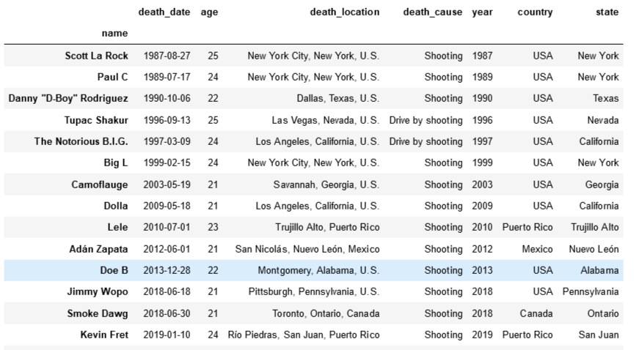
Above 20 years and below 25 years

Slide 12
Link to Analysis Report
Analysis

